Slide 1

Functional Exercise Impact Overview
Gary Dahnke
Functional Exercise Impact on Weight Training Overview
  Muscle and Joint Tracking 3rd Quarter of 2026
Data Analytics Presentation
October 12, 2026

Slide 2
Functional Exercise Impact
The following presentation will analyze the impact of Functional Exercises on muscle soreness and health of body joints in relation to weight training. The joints tracked include shoulders, elbows, wrists, hips, knees, and ankles.
Functional exercises are exercises that train your body to perform real-world movements and tasks rather than isolating a single muscle. The goal is to improve strength, balance, coordination, mobility, and stability in ways that carry over to everyday activities.
Controlled Articular Rotations (CAR) mobility exercises are a low‑intensity, joint‑specific mobility method that uses slow, deliberate circular movements to improve range of motion, lubricate joints, and reduce stiffness
Collection of exercises that I consider to have functional exercise impacts: Pull Ups, Shoulder CARs, Wrist CARs, Hip CARs, Knee CARs, Ankle CARs, Goblet and Deep Squat Holds, Assisted Squats, 90/90 Hips Stretches, Sideways and Reverse Walking. All CAR and Mobility exercises are completed in the morning.

Slide 3
Functional Exercise Impact
All scores for muscle soreness, joint flexibility, and joint soreness are scored on a scale from 1 to 10. All scores are taken after CAR/ Mobility exercises and stretches are completed in the morning.
Muscle Soreness – Rating (1-10) | Joint Flexibility Rating (1–10) | Joint Soreness Rating (1-10)
1 = No soreness 2-3 = Very mild 4-5 = Noticeable 6-7 = Moderate 8-9 = Strong 10 = Painful / Limiting | 10 = Excellent / full comfortable range 8-9 = Very good mobility 6-7 = Good mobility 4-5 = Normal but not smooth 2-3 = Slight stiffness 1 = Very stiff / restricted | 1 = No soreness 2-3 = Very mild 4-5 = Noticeable 6-7 = Moderate 8-9 = Strong 10 = Painful / Limiting

Slide 4
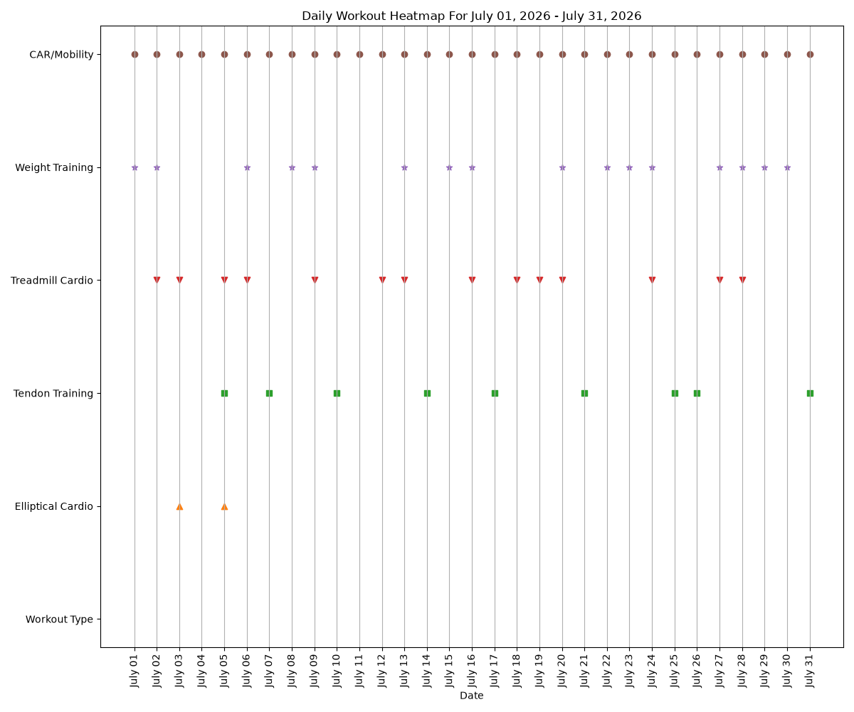
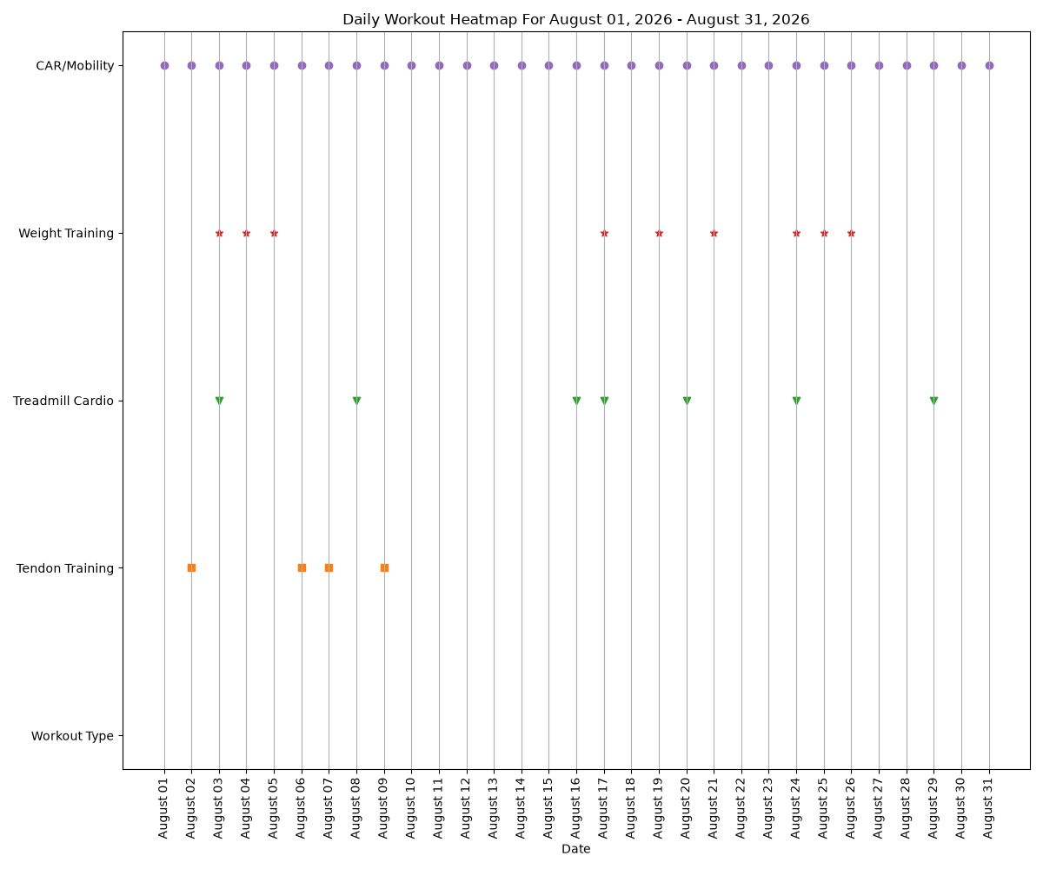
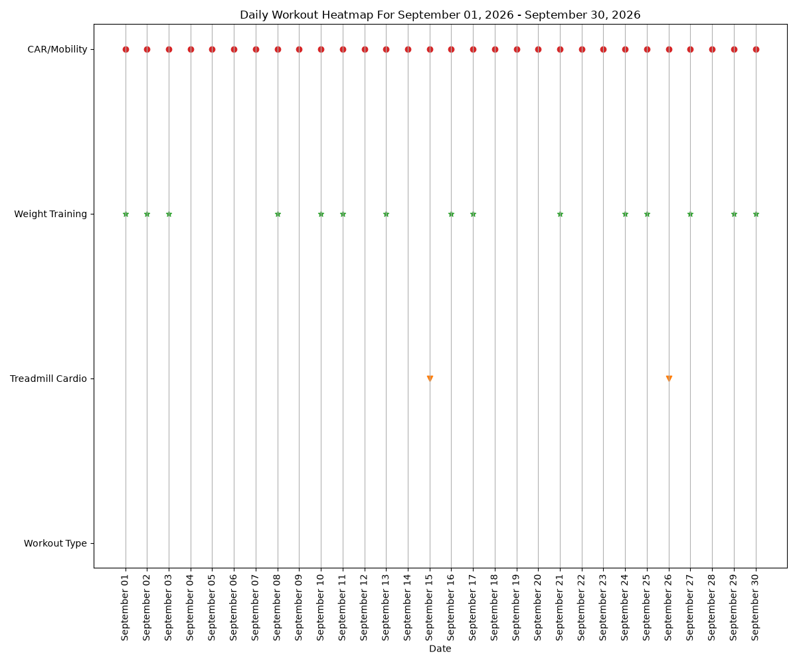
Daily Workout Heatmap (July 1 – Sept. 30, 2026)

Slide 5
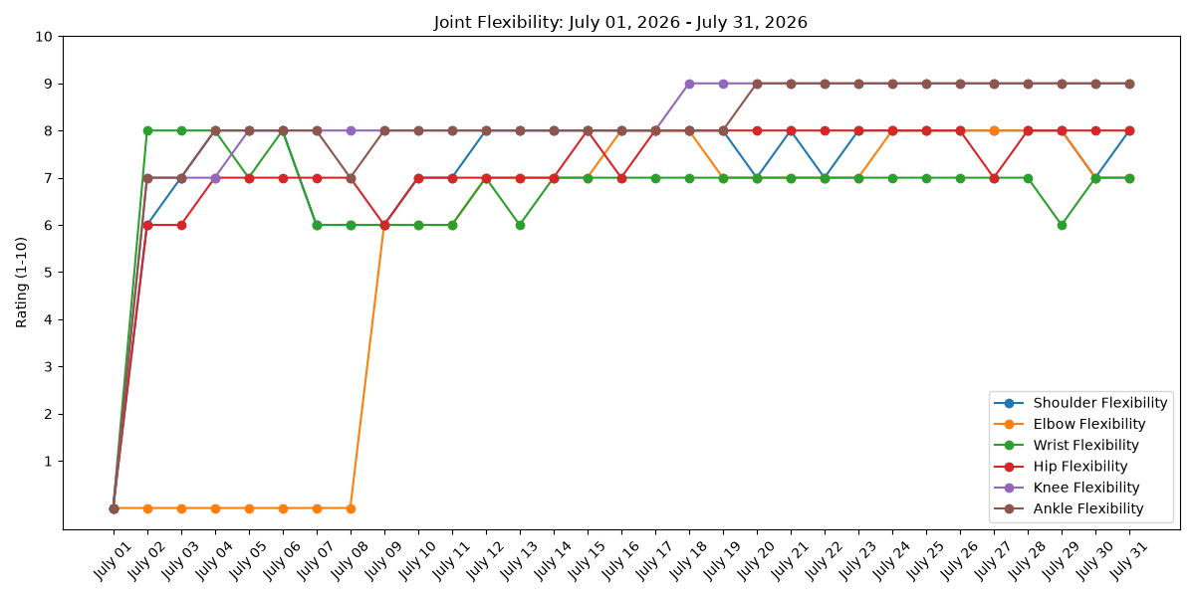
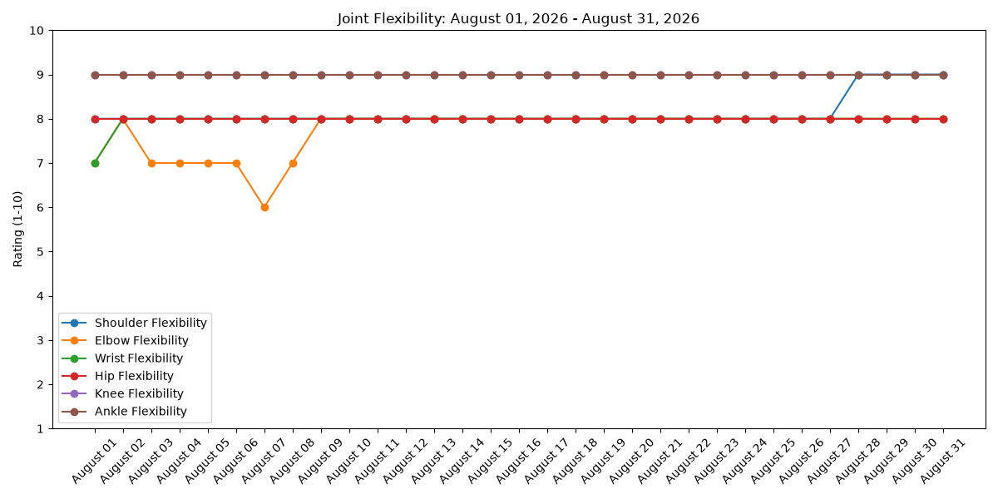
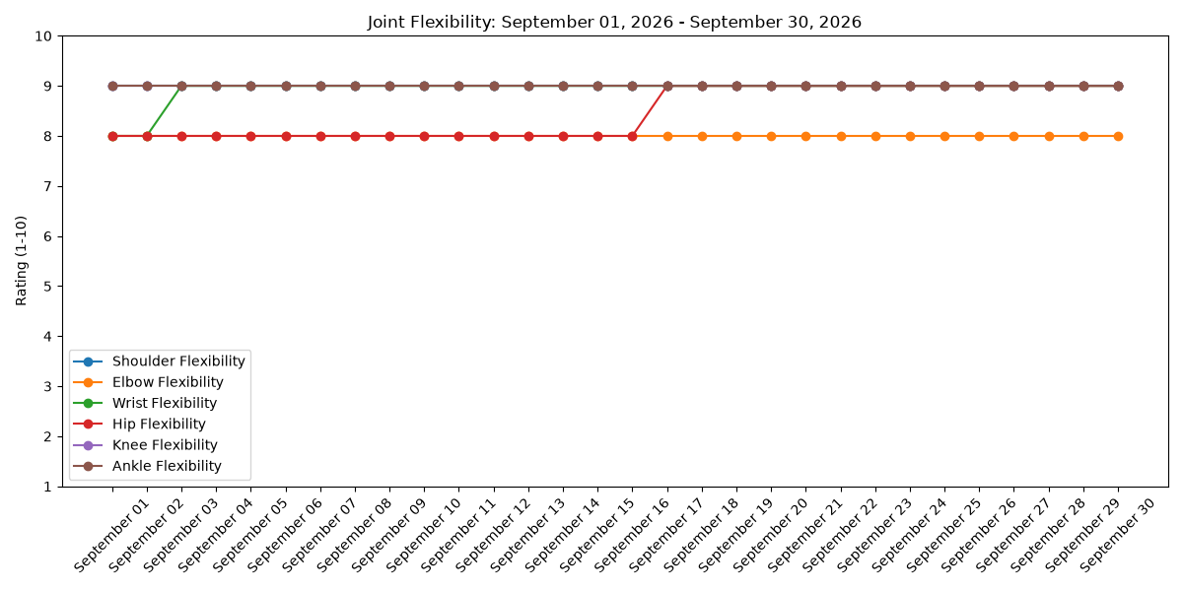
Joint Flexibility (July 1 – Sept. 30, 2026)
Improvement in flexibility of all 6 joints with scores from the 6 to 9 range in July to 8 to 9 range in September.
Wrist, shoulder, and hips joints have shown the greatest improvements.
With the introduction of daily CAR and Mobility exercises along with the 90/90 Hip stretch, joint flexibility has improved.

Slide 6
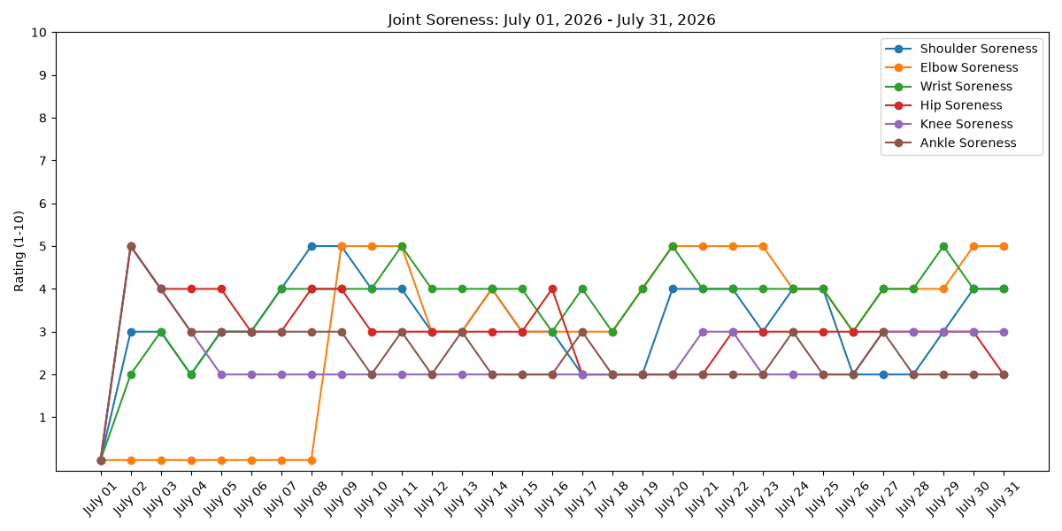
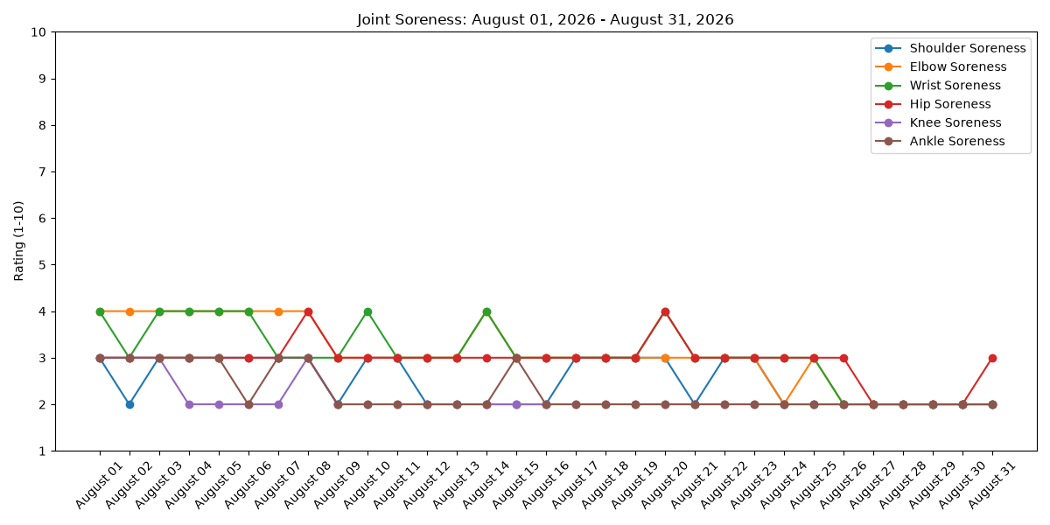
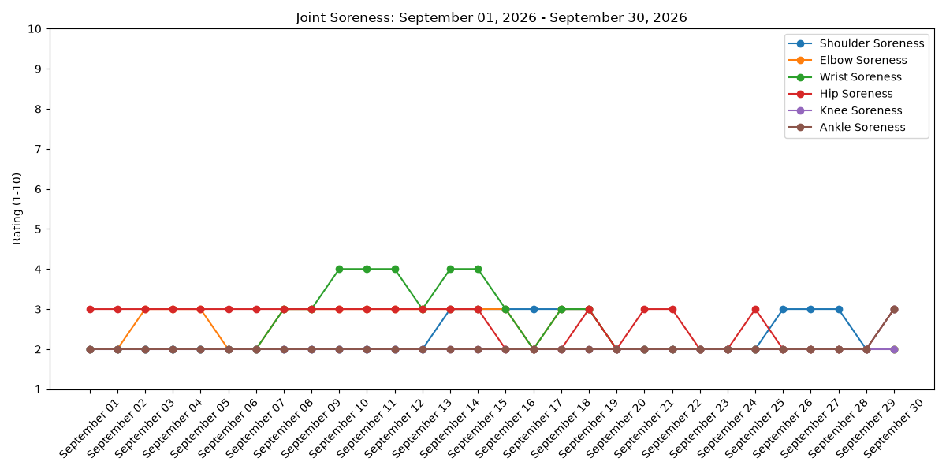
Joint Soreness (July 1 – September 30, 2026)
Improvement in soreness of all 6 joints with scores from the 2 to 5 range in July to 2 to 3 range in September.
Elbow, wrist, shoulder, and hips joints have shown the greatest improvements.
With the introduction of daily CAR and Mobility exercises along with the 90/90 Hip stretch, joint soreness has decreased.

